Slide 1

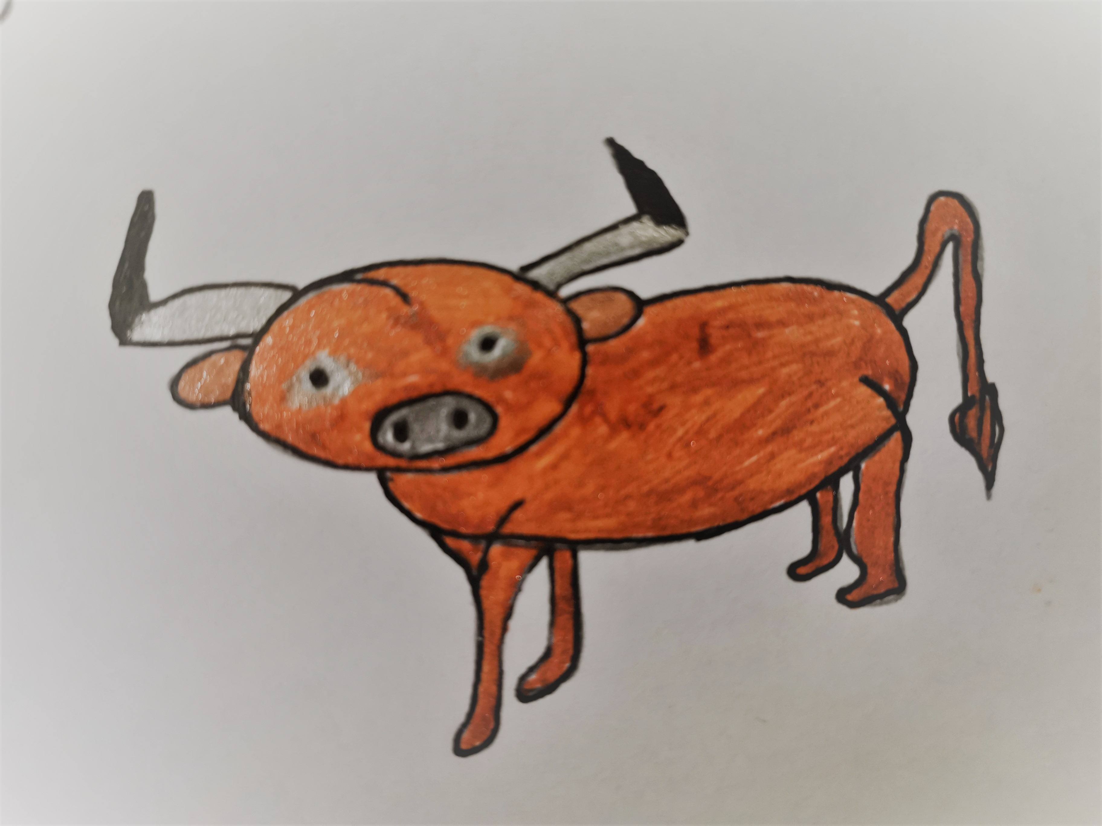
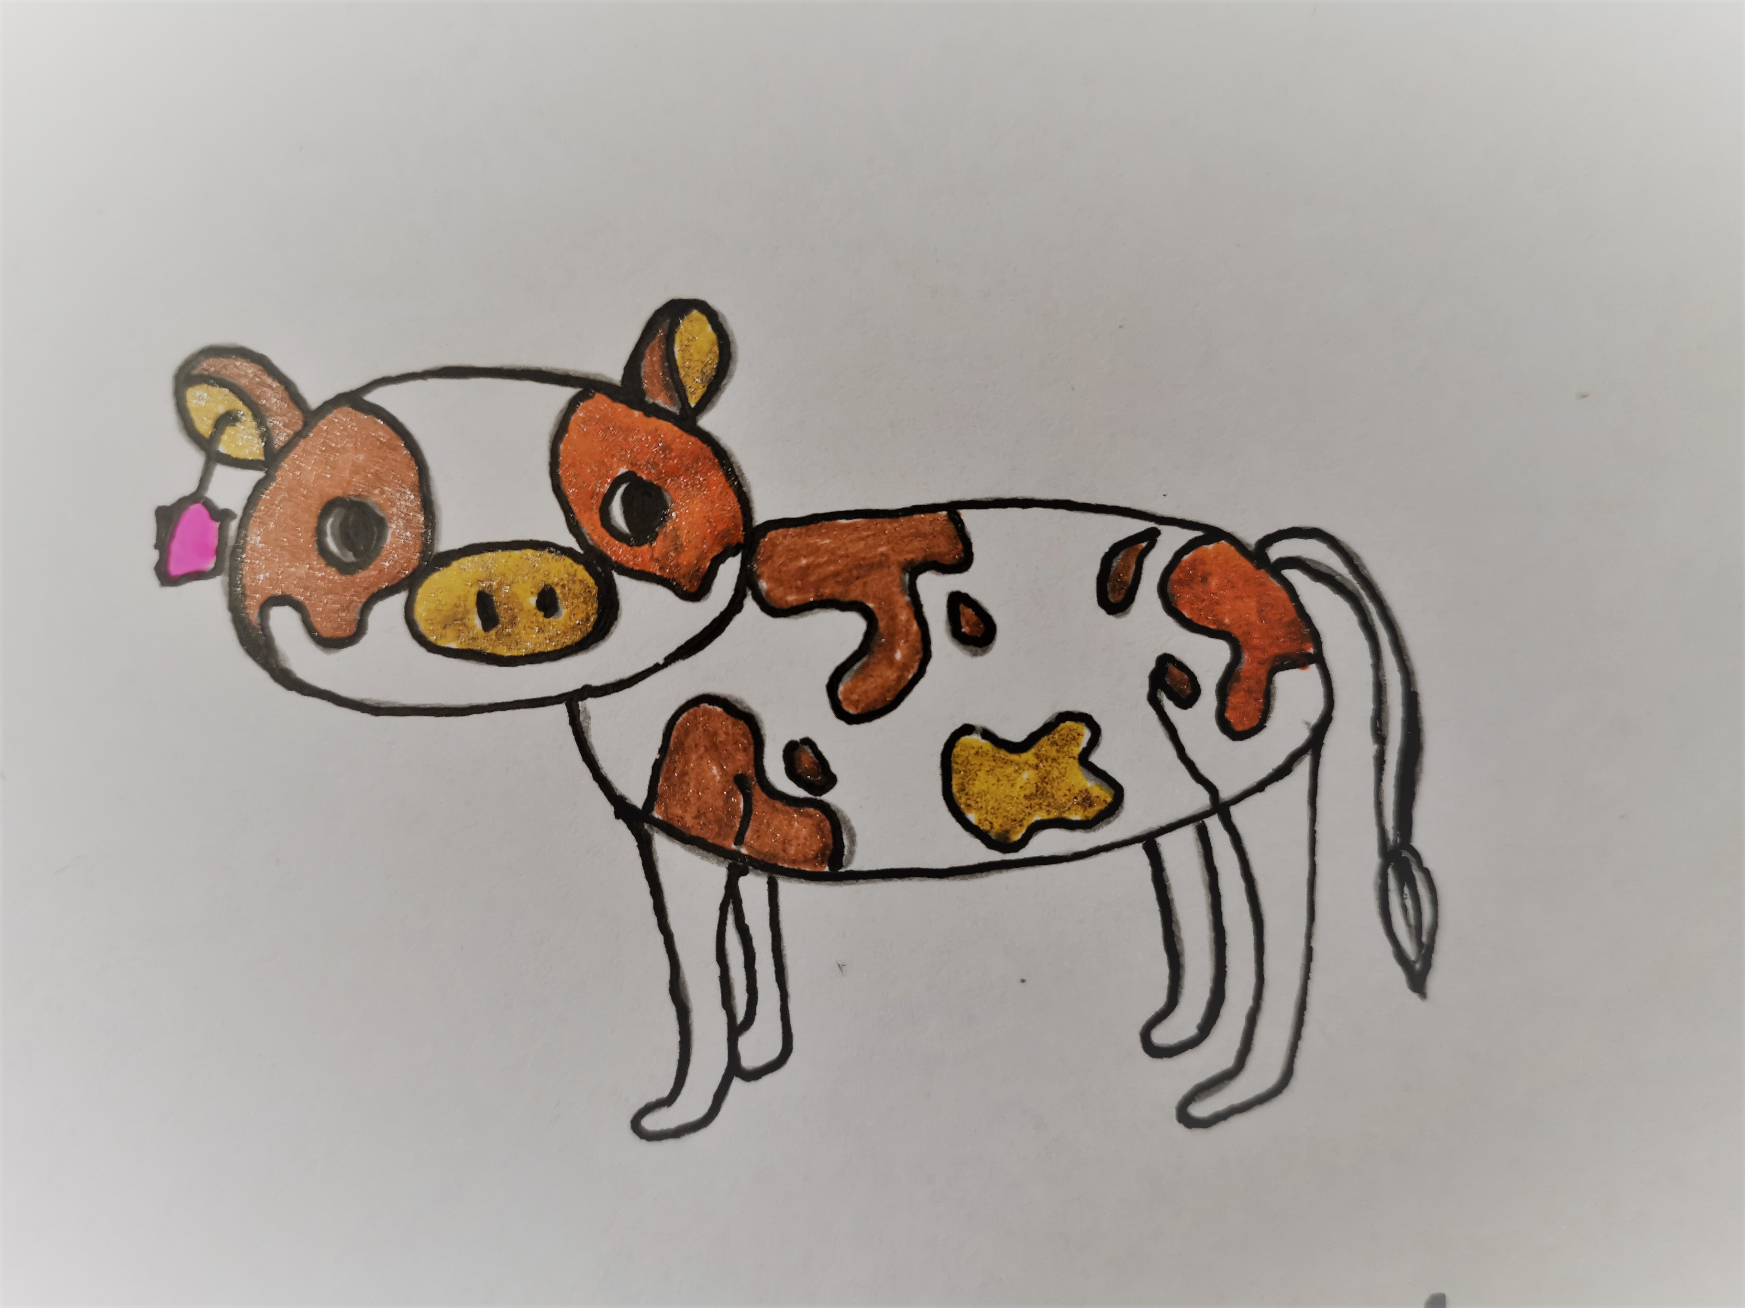

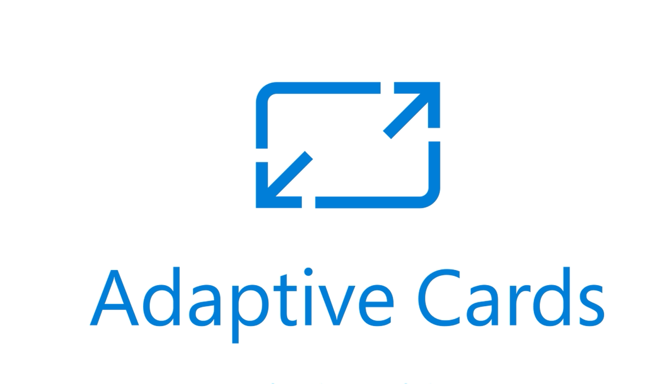

Lab 1 - BULLS and COWS
1234
8763
5734
0923
6703
3467
Notes:
Hi, welcome to PowerLabs video. We start our online channel with the video series on how to build Bulls and Cows game with Microsoft Teams, Adaptive Cards and Power Automate.

Slide 2
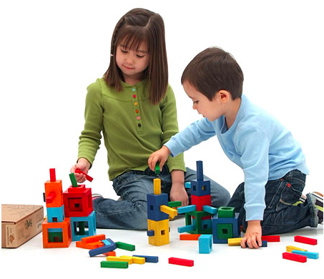
Experiential Education
"We do not learn from experience...
we learn from reflecting on experience."
John Dewey, an American philosopher, psychologist, and educational reformer
Notes:
Learning can be fun sometimes. And sometimes we need to add a little bit of extra sprinkles on top to make boring or serious things look interesting. Building games is always a good fun. That's why today we will start learning some grownup tools by building a game.

Slide 3
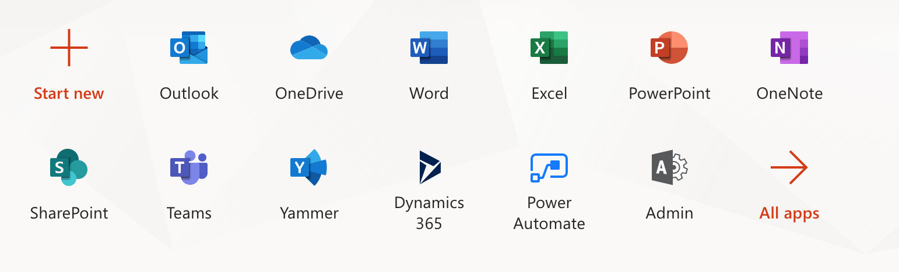

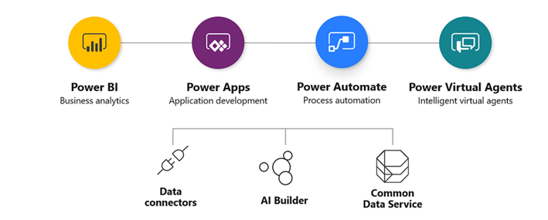
Office 365 + Power Platform
Notes:
If you use Office 365 for work you can find all these tools under your account. You can build pretty much anything by using these tools as standalone or combining them together. We will use Office 365 and Power Platform for our labs because it's easy to learn, doesn't require coding an it can be done quickly.

Slide 4
Bulls and Cows
https://en.wikipedia.org/wiki/Bulls_and_Cows
Code breaking game
4-digits, unique
Any number can be solved in 7 turns.
Min 5.2131 turns
Notes:
It'a simple two-players game. The first player generates a 4-digit code and the second payer is trying to guess it. Digits in the code are unique. Player 2 has to guess all digits and put them in the correct spots. For each guessing attempts of the second player the first player generate a coded response. When the second player guesses the code game is over.

Slide 5
Bulls and Cows - example
Code: 1234
Attempt: 3854
Coded Response:
4 – correct digit, correct place -
3 - correct digit, wrong place -
Notes:
Let's have a look at the example. At the first attempt we guessed the last digit correctly. In the respones it will be coded as 1 bull. And another digit, 3, is correct but it's in the wrong spot. This is why it's coded as a cow. You can build it to play with your friend in a chat or on a channel or you can play with a computer. We will be building the game to play with a computer.

Slide 6
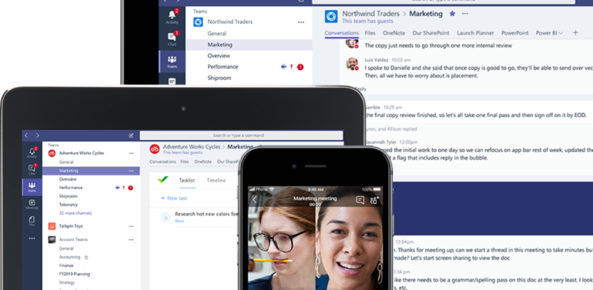
Microsoft Teams
Meetings
Channels
Chats
Notes:
Usually serious people use Microsoft Teams to virtually connect. There are many tools inside Teams like chats, channels and meetings. We will use Teams as platform to run our game.

Slide 7
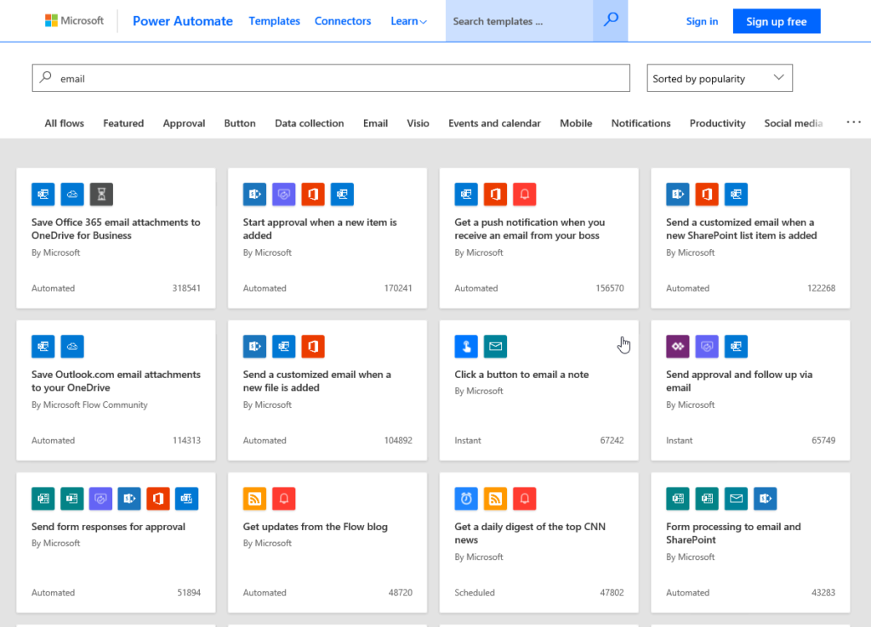
Power Automate
Connect
Automate
Execute
Notes:
Power Automate is a no-code way to connect multiple actions in one flow to run in the context of Office 365. You can pull data from multiple applications, analise and process then write it back or send the result via email, text or post in on social media. Power Automate can be used in the context of Microsoft Teams to automate business processes and replace more traditional forms of office communications like emails.

Slide 8
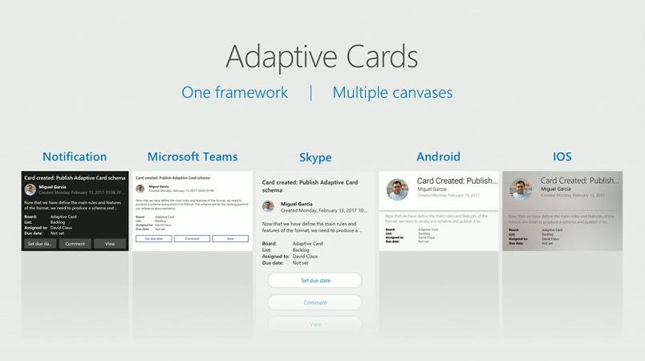
Adaptive Cards
JSON
UI component
Multiple canvases
Notes:
Adaptive card is a universal card which can be use in the context of Office 365 application on a desktop or mobile device, the same card will look differently to adapt to the application it's embeded into.

Slide 9
Game Design
Application
Logic
UI
Notes:
We will build the game in Microsoft Teams using Power Automate to generate cards and reponses and process attempts.

Slide 10
Video

Slide 11

Who Are We?
https://www.linkedin.com/in/olenagrischenko
https://www.linkedin.com/in/grischenko
https://technomancy.com.au/
https://msolenacrm.blog/

